Slide 1
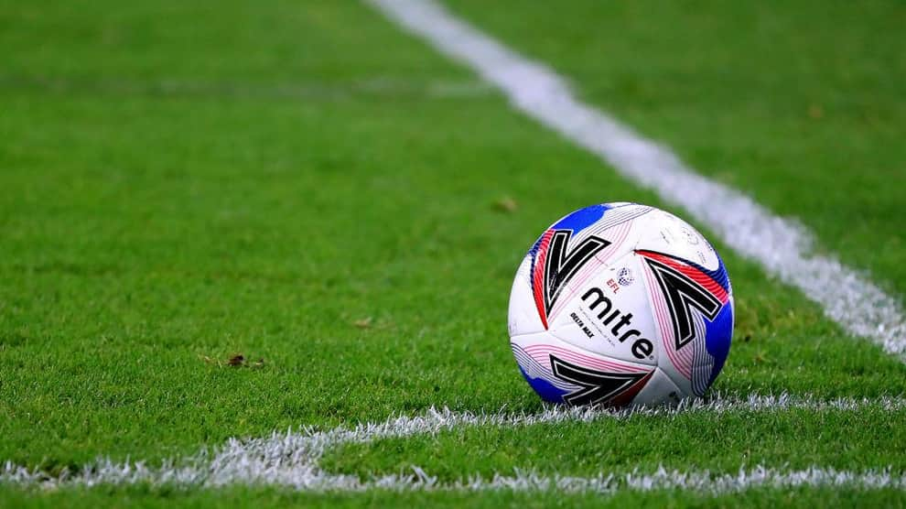
PRE SEASON MEETING
May 7th, 2024

Slide 2
Agenda
Roll call
Welcome
OASC Business Review
Team Management
Game Day Management
Division Management
Cups
Discipline
Tournament
Questions

Slide 3
Welcome
78 teams will participate in the Ottawa Adult SC in 2024
63 15

Slide 4
# of OASC teams by year
Our team entries have doubled since 2019

Slide 5
2024 OASC dashboard
Total 2024 teams
78

Slide 6
# of teams by year in our league
Our team entries have increased by 60% since 2019

Slide 7
2024 dashboard our league
Total 2024 teams
63
Returning teams
45
New 2024 teams
18
Lost 2023 teams
13

Slide 8
Early Bird Special
56 teams participated in the Early Bird Special
This was a great success that will be repeated in 2025
Thank you to the team managers who participated

Slide 9
Business partnerships
We are keen to add value to our members through business partnerships
Partnerships have to be a win-win for both sides
Pass on your suggestions for future partnerships to Dawn and we will follow up

Slide 10
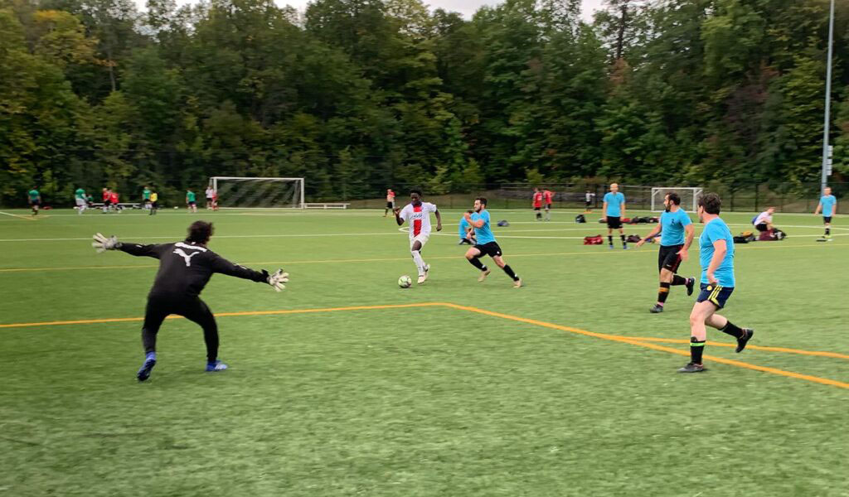
City of Ottawa
The Richcraft field partnership gives us priority access to the turf field
The initial agreement concludes in 2024 but we will still be able to use the field after that
There are currently no plans on a refurbishment

Slide 11
Atletico Ottawa
Each team will receive tickets for a game on May 25th
10 tickets for 11 v 11 teams
7 tickets for 7 v 7 teams
Discounted tickets for other games can be purchased through our website
We also have been given a 10% discount on merchandize

Slide 12
FuboTV
Sign up for an annual subscription from FuboTV and the OASC receive a commission
The commission is then given as a credit to your team
FuboTv carries the Premier League and Siere A

Slide 13
Ottawa Senators
Discounted Ottawa Senators tickets can be purchased through our website
Look for the announcement for 2024/5 tickets later in the summer

Slide 14
Ottawa South United
Ottawa South United are our biggest customer for field sales at Richcraft
Its in our best interest that their summer camps at Richcraft are a success

Slide 15
A good reputation increases partnerships
We have a good reputation in the community. Let’s make sure that continues
OASC defines a uniform as a jersey, shorts and socks. Teams must wear matching uniforms which includes same colour shorts and socks.
Encourage your players to be organized and play in a friendly and sporting manner

Slide 16
Multi media plans
We have purchased a Veo camera and hope to film some games this season
We are hoping to hire a contractor to manage that program
Match videos and highlights will be available on our YouTube channel

Slide 17
Social media
We hope to grow our social media activity this year.
We will be hiring a marketing contractor to assist in this program

Slide 18
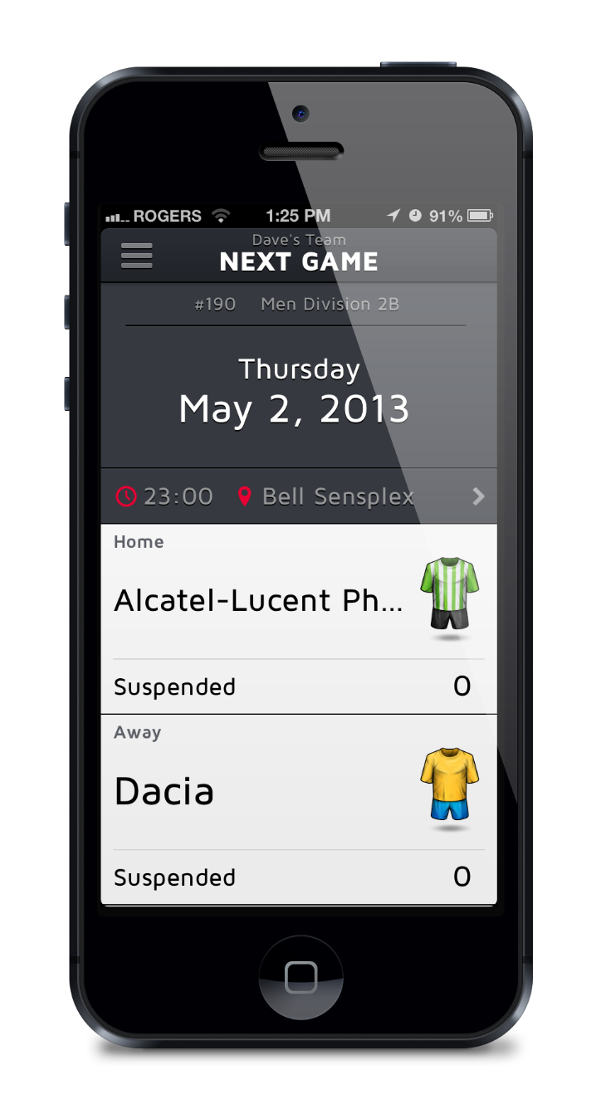
On the ball
Look out for regular ‘On The Ball’ newsletters throughout the year

Slide 19
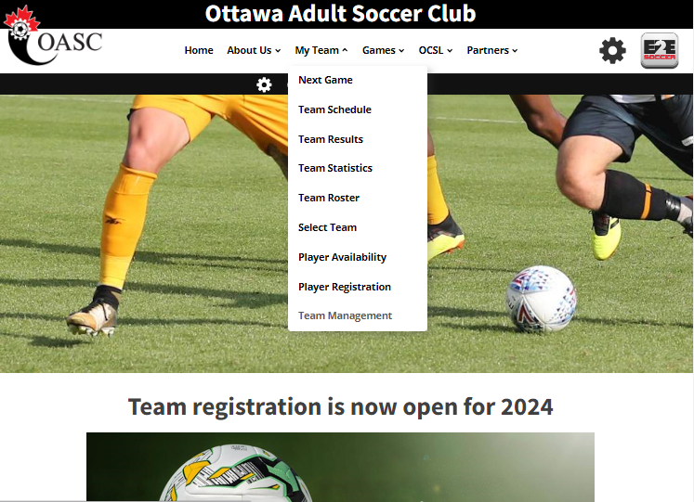
Team management
Each team manager needs to activate their website account
Each player needs to register on the website
Demonstrations of these processes can be found on the website

Slide 20
Team management
Only properly registered players may play for your team
Please ensure all your players are registered at least 48 hours before your first game
Players who register later than this may have to miss the first game

Slide 21
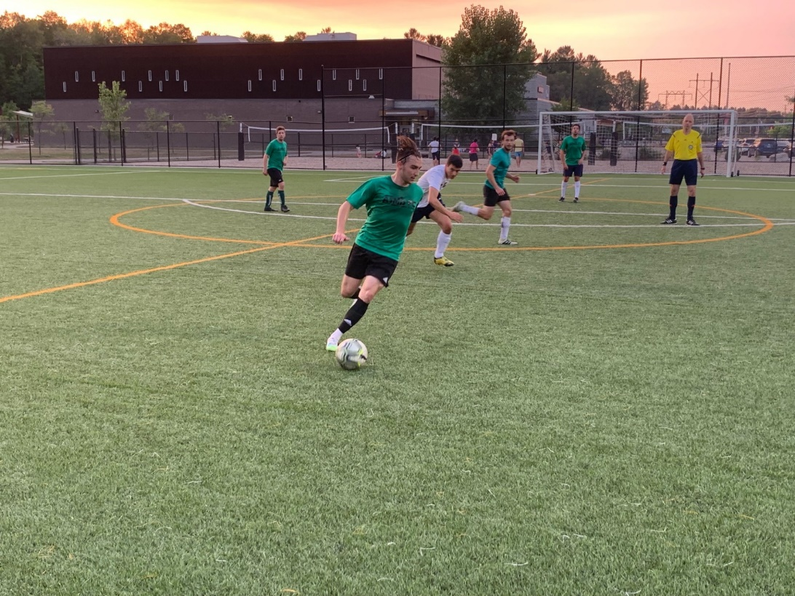
Game day management – Team managers
What to do on game day?
Bring 3 copies of your game sheet and give them to the referee
After the game submit a game report on the website within 24 hours

Slide 22
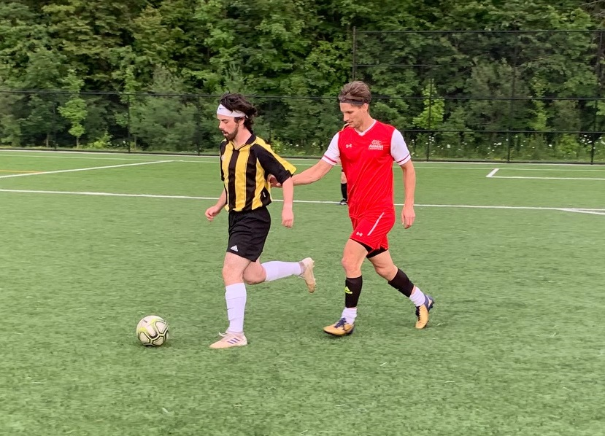
Game day management - Players
What to do on game day?
Bring government issued ID to the game and present it to the referee
Driving license
Health card
etc.

Slide 23
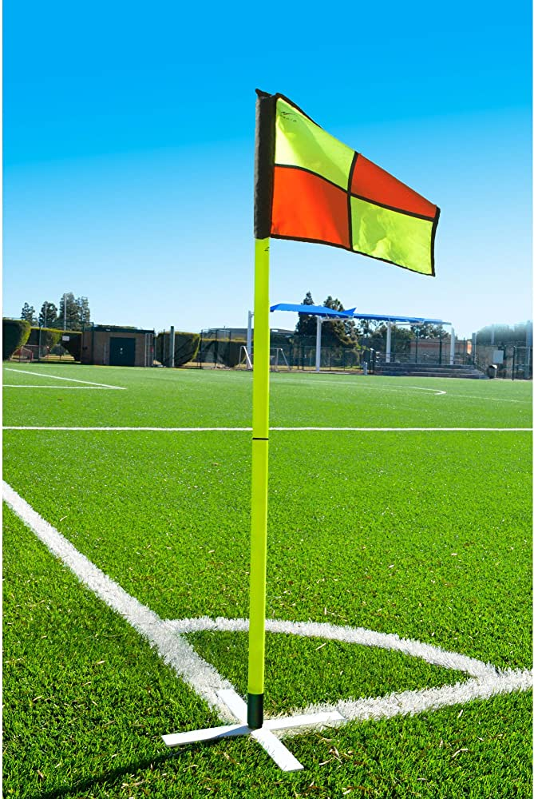
Game day management - Equipment
What to bring on game day?
All teams
A game ball
A pump
11 v 11 teams only
A goal net
2 corner flags
Away team changes when there is a colour clash
The following fields will have nets permanently setup:
Brookshire Park
Insmill Park
Roland Michener Park

Slide 24
Important Reminders
Shin pads
Standard sized shin guards must be worn by all players. They must also be completely covered by socks and provide proper shin protection.
Game Sheets
BRING them to the referee. Don’t make them chase you down
Game starts
Teams need to be ready on time. If teams are not ready, the referee will start their watch, games will be shortened
Air Quality Policy
The EODSA is in the process of publishing a policy with regards to the air quality.
7 v 7 Rule Reminder
Sliding is not permitted. Goal keepers are permitted to slide INSIDE the box only

Slide 25
Men Division 1
Regular game night - Tuesday
Season starts - Tuesday May 21st
# of games - 14
Relegation - 8th place

Slide 26
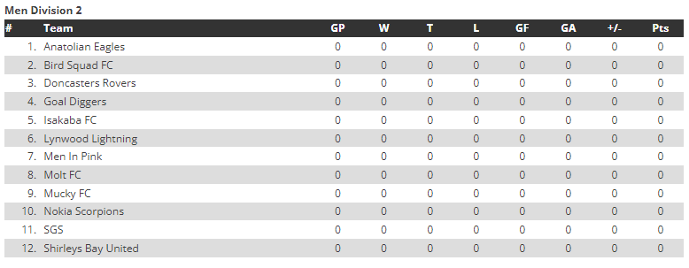
Men Division 2
Regular game night - Wednesday
Season starts - Wednesday May 22nd
# of games - 14
Promotion - 1st place
Relegation - 12th place

Slide 27
Men Division 3
Regular game night - Thursday
Season starts - Thursday May 23rd
# of games - 14
Promotion - 1st place
Relegation - 8th place

Slide 28
Men Division 4
Regular game night - Thursday
Season starts - Thursday May 23rd
# of games - 14
Promotion - 1st place

Slide 29
Men Over 35
Regular game night - Wednesday
Season starts - Wednesday May 15th
# of games - 14
Location - All games at Richcraft
Times - 6:00pm, 7:10pm

Slide 30
Women Division 1
Regular game night - Monday
Season starts - Monday May 13th
# of games - 14
Location - Richcraft & Bell Sensplex
Times - 6:00pm, 7:10pm, 8:20pm, 9:30pm

Slide 31
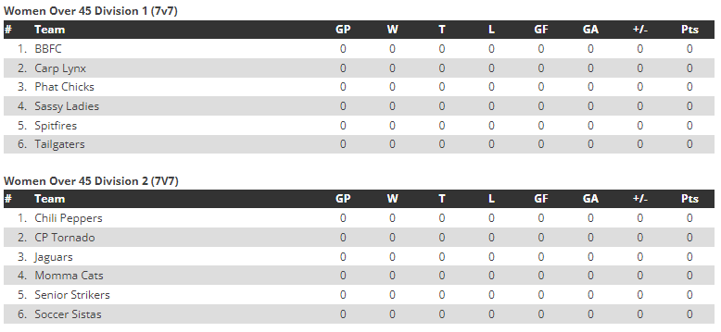
Women Over 45 Div 1 & 2
Regular game night - Monday
Season starts - Monday May 13th
# of games - 14
Location - Richcraft & Bell Sensplex
Times - 6:00pm, 7:10pm, 8:20pm, 9:30pm

Slide 32
Cups
We have 2 cup competitions for our 11 v 11 teams
Challenge Cup open to all
Presidents Cup for Division 3 and 4 only
Challenge Cup entry fee for Division 3 and 4 teams is $80

Slide 33
Cup Schedule
Monday May 13th – Entries close
Wednesday May 15th – Cup draw
Monday June 3rd – Round of 32
Week of June 18th – Round of 16
Week of July 15th – Round of 8
Week of August 12th – Semi finals
Week of September 2nd – Finals

Slide 34
Discipline
We follow the Ontario Soccer’s Discipline policy and procedures
Discipline hearings are scheduled each week throughout the season

Slide 35
Discipline Index
Each team will have a discipline index as follows
1 point for each yellow card
2 points for each red card
Index = total points / # of games played
Teams who score over 0.7 in the season will be placed on a performance bond for 2025

Slide 36
Tournament
The tournament format will be 7 v 7
All teams can enter
It is scheduled for the weekend of September 14th

