Slide 1
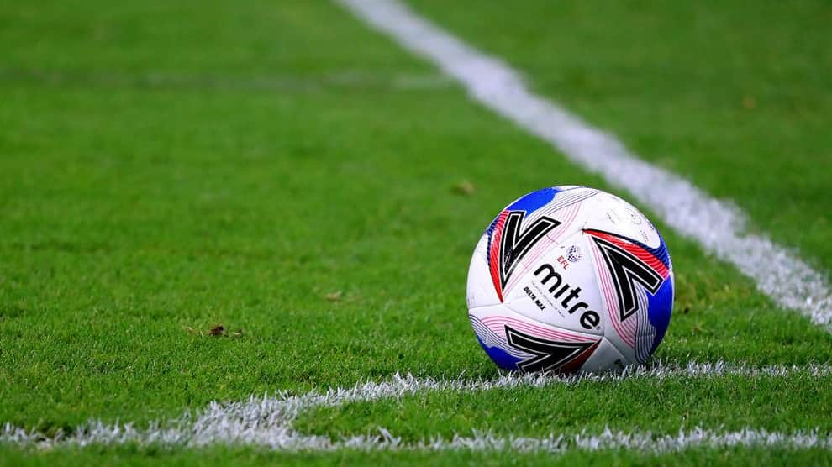

Over 35/50 Tournament
Saturday 20th September, 2025

Slide 2
About our Club
We are Ottawa’s biggest adult only soccer club
We run our own league and enter teams in the OCSL
We fielded 72 teams in the 2025 season
We are members of the EODSA
Find out more at www.ottawaadultsoccer.com

Slide 3
Tournament Overview
Divisions Sanctioned
Over 35 By EODSA & Ontario Soccer
Over 50
Location Entry Fee
Kanata $450
# of games
3 games guaranteed per team
4th game for the finalists
Each game is 40 minutes

Slide 4
Who can enter
Any OCSL team currently playing in the Old Timers or Masters divisions
Any OASC team or combined teams
Any team playing within Ontario Soccer registered as Old Timers or Masters
All players must meet these age requirements to participate
  Over 35 division – player was at least 35 on January 1st 2025
  Over 50 division – player was at least 50 on January 1st 2025

Slide 5
How to enter
Visit www.ottawaadultsoccer.com and follow the instructions
Teams will be asked to
  1. Complete a registration form
  2. Submit a $200 deposit (not refundable)
  3. Pay balance by September 16th 2025

Slide 6
Location and schedule
Games will be played in Kanata on Saturday September 20th, 2025
3 round robin games will be played at
  9am, 11am and 1pm
  or
  10am, 12pm and 2pm
Finals will be played at 3:30pm
  (note this will be dependent on the number of teams registering.)

Slide 7
Tournament organizers
The Tournament will be managed by Kevin Judd
The Tournament will be administered by Dawn Dinsdale
For further information please contact Kevin at
  (343) 996 7675
  Kevin.judd10@gmail.com

