Slide 1
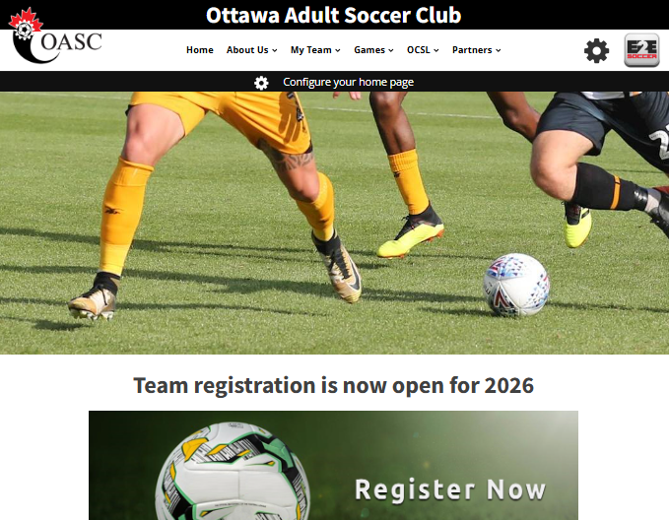
Ottawa Adult Soccer Club
OASC website is www.ottawaadultsoccer.com

Slide 2
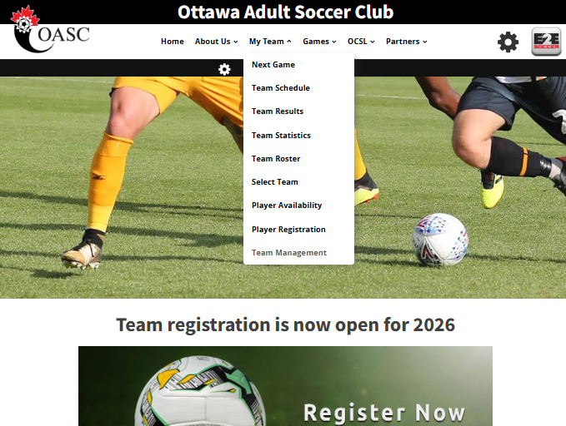
Team Management
Team Managers need to log into the site with the Team Management tool
You can find this tool under the My Team menu

Slide 3
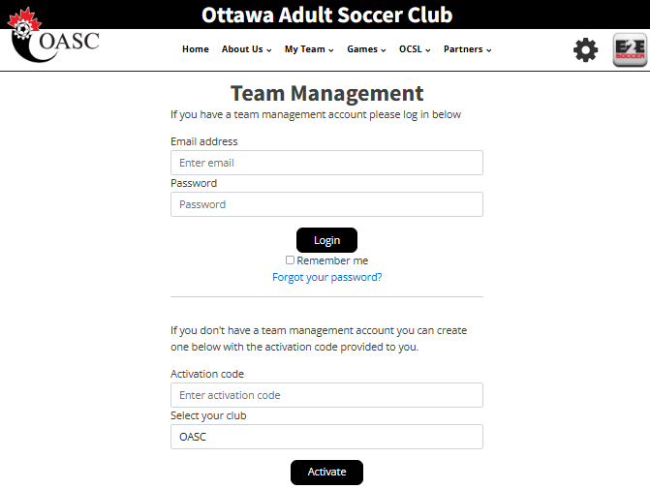
Activating a Team
To activate your account, go here and enter the activation code provide by the league.
Then click the Activate button
2026 Activation Code
Please contact Dawn
(case sensitive)

Slide 4
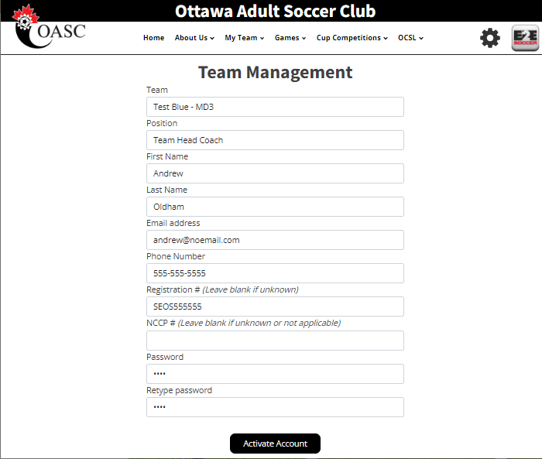
Team Official Information
Make sure that you select the correct team here
Fill in the rest of the page and click the Activate Account button

Slide 5
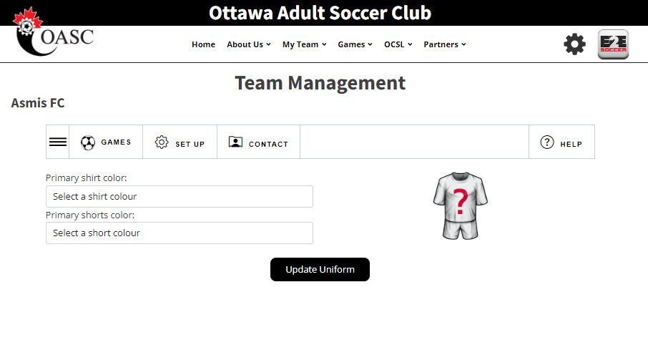
Modules
You will now be taken to the Team Management module. There are 4 tabs in this module
Games
Set Up
Contact
Help
Click on a tab to move around the module

Slide 6
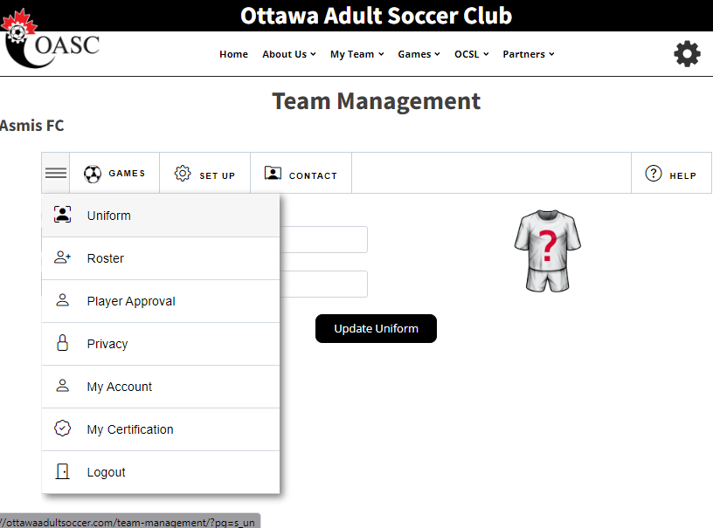
Modules Continued
In each tab is a series of tools
Click on the 3 lines to visit that tool

Slide 7
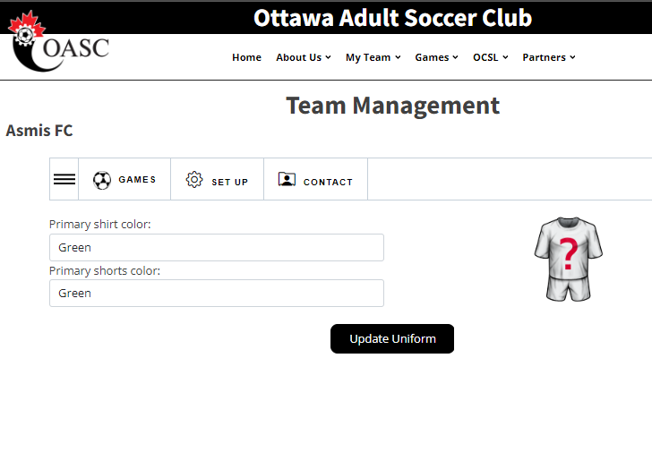
Updating Uniforms
Start in the Set Up menu
First enter your uniform by selecting your shirt and shorts in the drop downs
Click the Update Uniform button to save.
Note that your team will not be considered activated until your uniform has been updated.

Slide 8
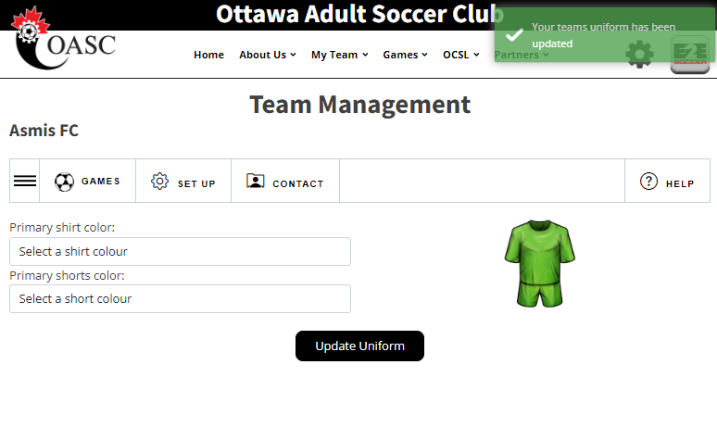
Uniform Confirmation
A green message will tell you that the action was successful
It will be red if there is a problem

Slide 9
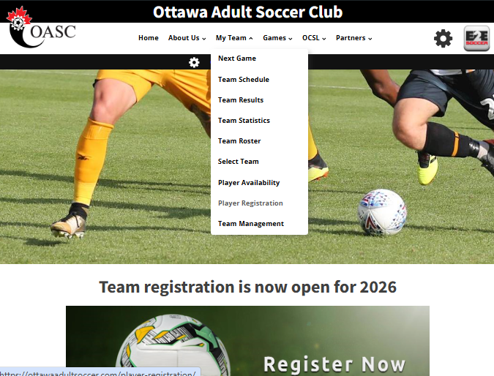
Player Registration
Your players will need to go to the Player Registration, under My Team

Slide 10
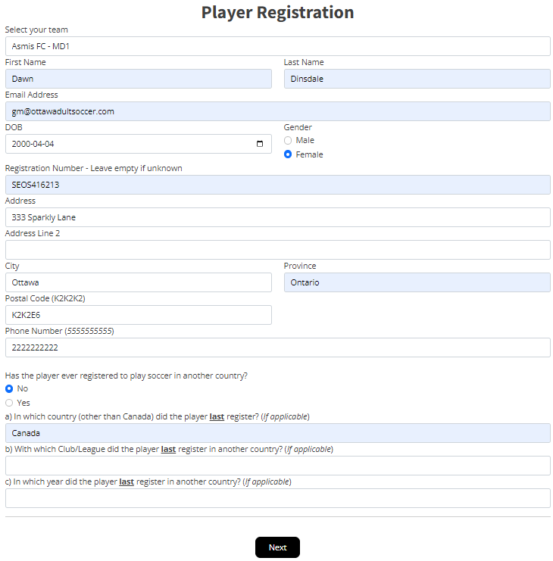
Player Registration
Ensure you choose the correct team to register to.
Fill out all required information.
Click Next

Slide 11
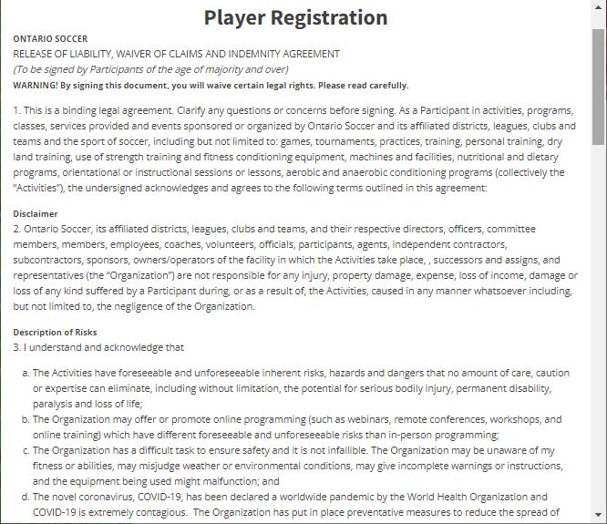
Waivers
Read through the waiver and at the bottom of the page, click “I Agree”

Slide 12
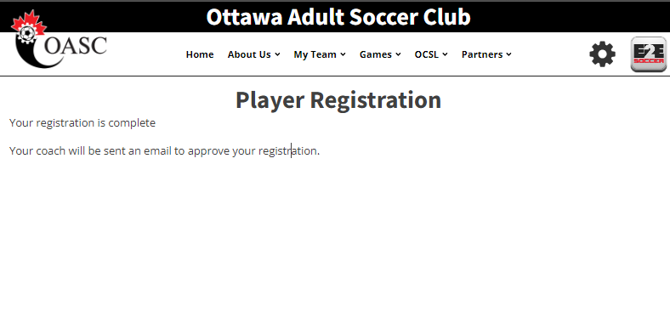
Player Registration Con’t
Player registration is now complete for the player.
Team managers will receive an email to approve their players registration.

Slide 13
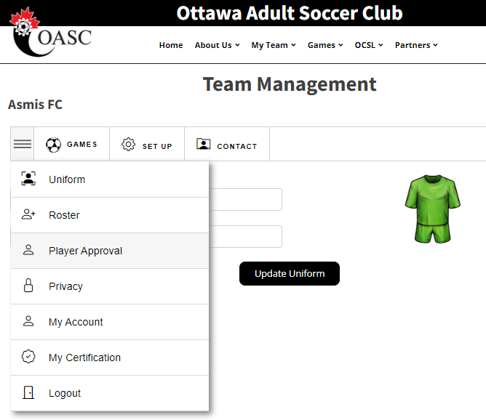
Approving Players
Ensure you are on the Set Up menu.
Click on the 3 lines and go to Player Approval.
Team Managers can approve or decline players here.
Team managers who are also players will need to go through this process.

Slide 14
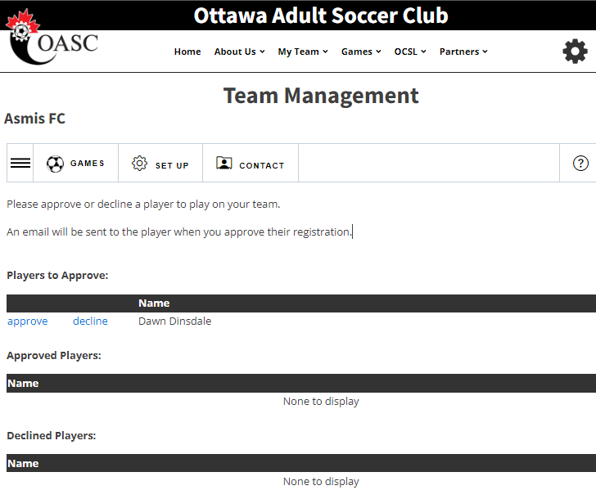
Approving Players
Click on approve or decline.
Note that until the General Manager approves the players, they will not appear on the game sheet.

Slide 15
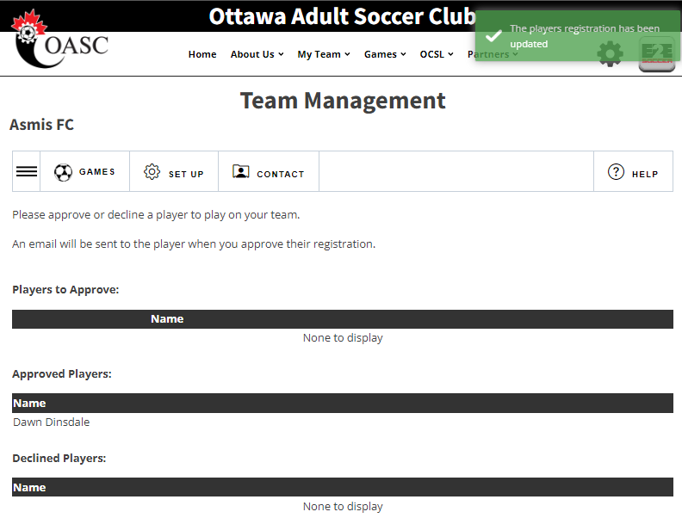
Player Approval
Once players have been approved, a green box will appear.
The League will register the players with Ontario Soccer.

Slide 16
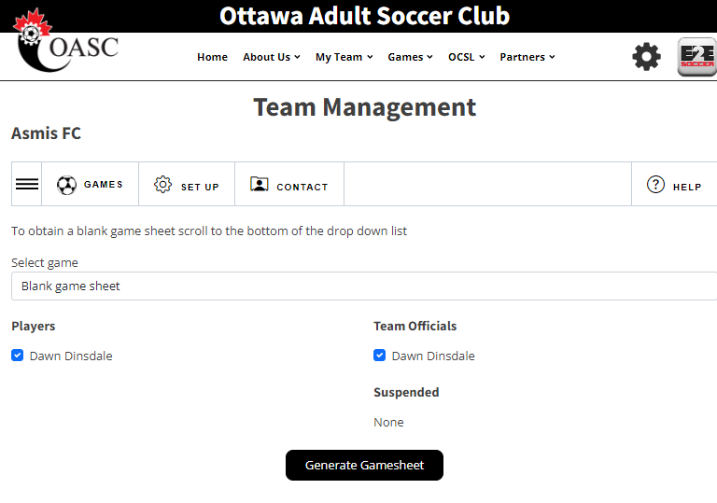
Generating Gamesheets
To create a game sheet, go to the Games tab, click on the 3 lines, and go to game sheets
Choose the game from the drop-down menu.
Select the players, who will be attending the game.
Click Generate Game Sheet.
Print it out and bring 3 copies to the game

Slide 17
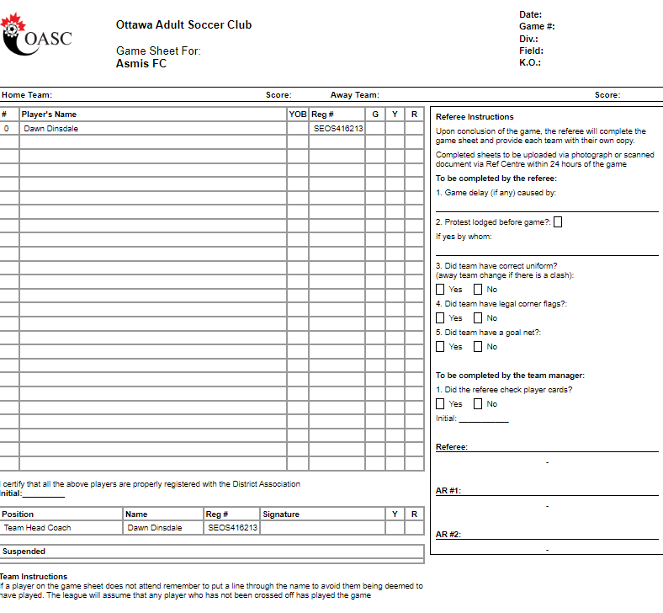

Slide 18
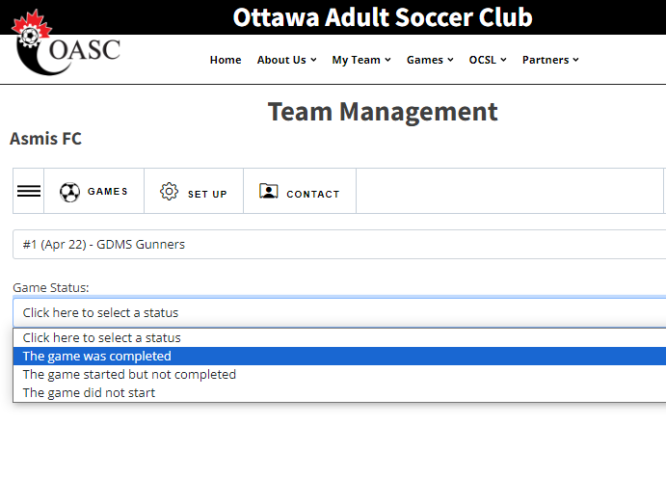
Game Reports
After the game go to the Game Report tool to submit a report
Follow the instructions to completion
When both teams have entered a game report the standings will be updated
Please ensure this is completed 24 hours after your game to avoid receiving a fine.

Slide 19
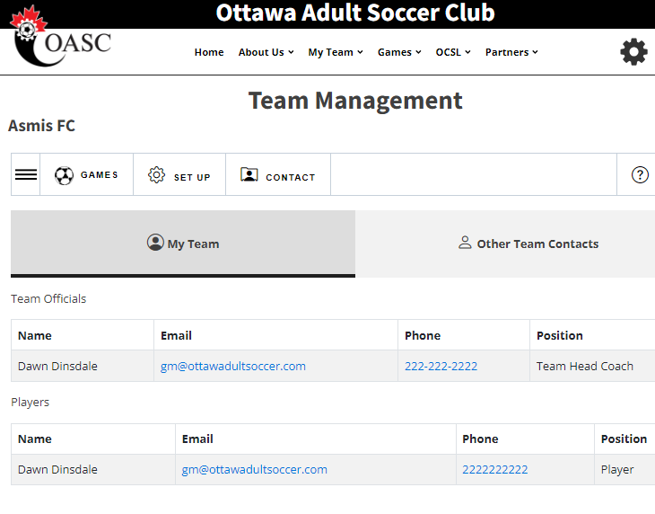
Team Contacts
Your teams contact information will be available on the Contact tab when logged in.
All other team contact information can be found on the Other Team Contacts tab

