Slide 1
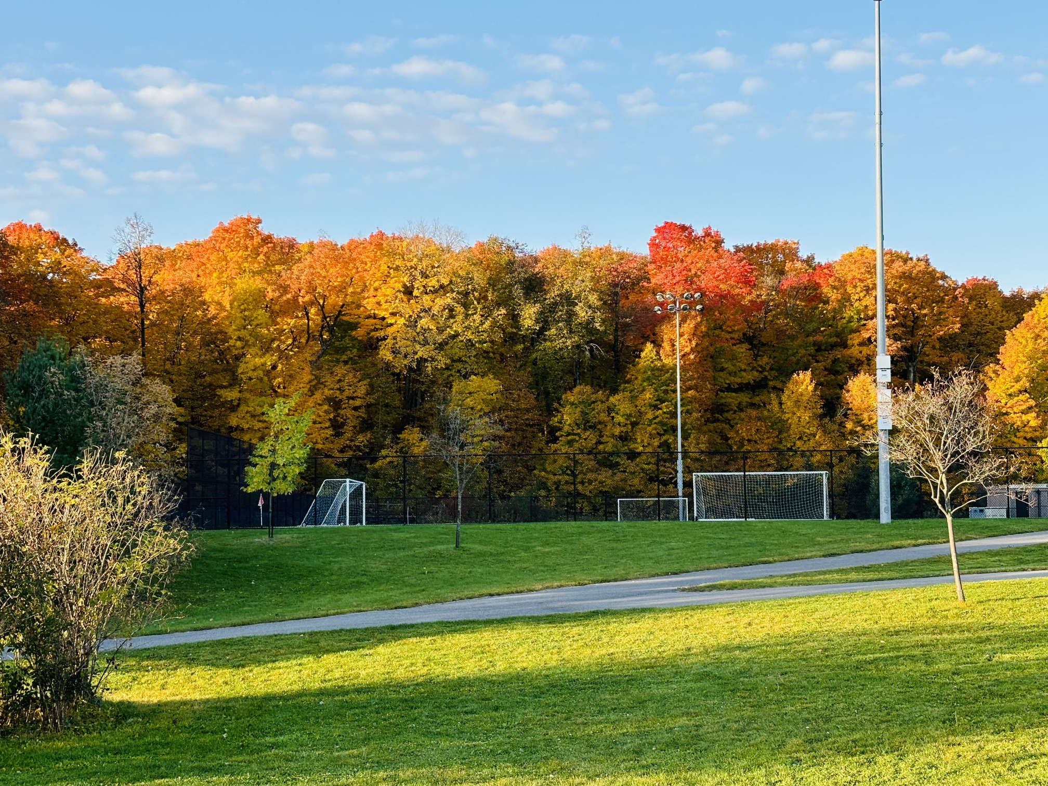

Fall League

Slide 2
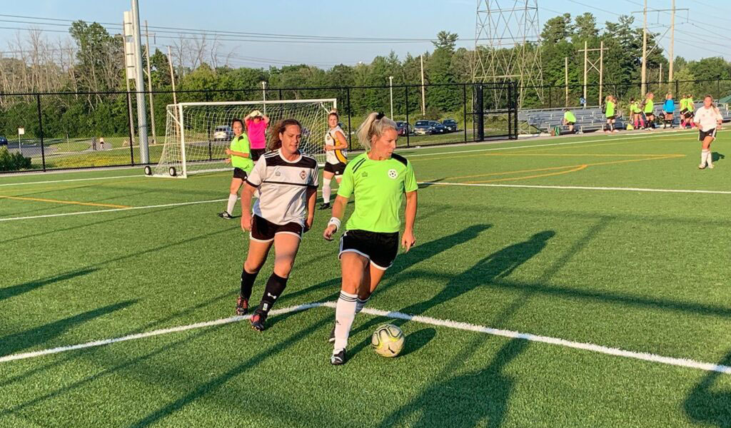
Summary
A new competition from the OASC
All games played at the Richcraft Recreation
Complex
7 v 7 games only
Games are 50 minutes long
Total of 7 games
Game day is Sunday
Kick offs on the hour between 12pm and 6pm
Season starts Sunday September 13th
Season ends Sunday November 1st

Slide 3
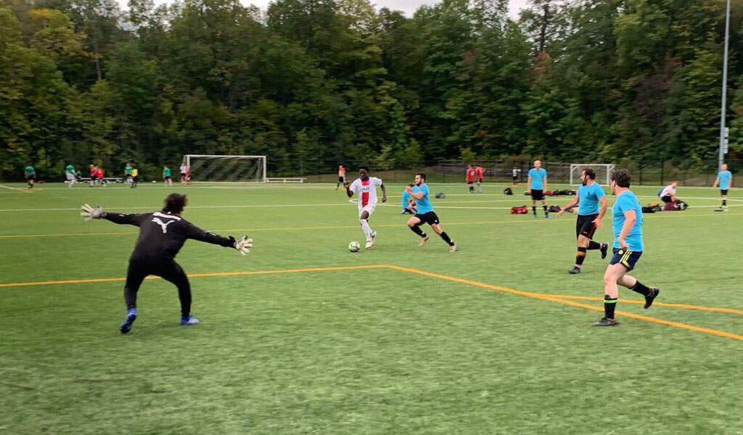
Who can enter?
There is limited space
We only have room for 24 teams
Priority will be given to the 2026 OASC teams
New teams from outside the OASC will only be
accepted if there is room

Slide 4
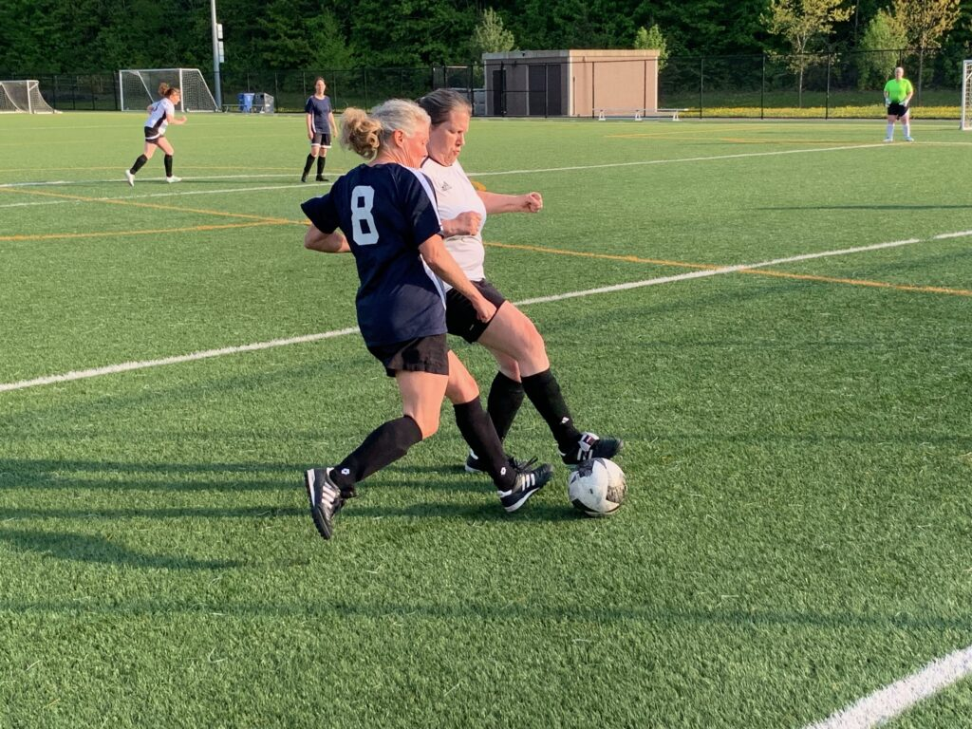
What divisions are being offered?
Men
Women
Men over 35
Women over 45
Yes we will offer tiered divisions
Teams will be ranked based on your 2026 summer
record
Will the divisions be tiered?

Slide 5
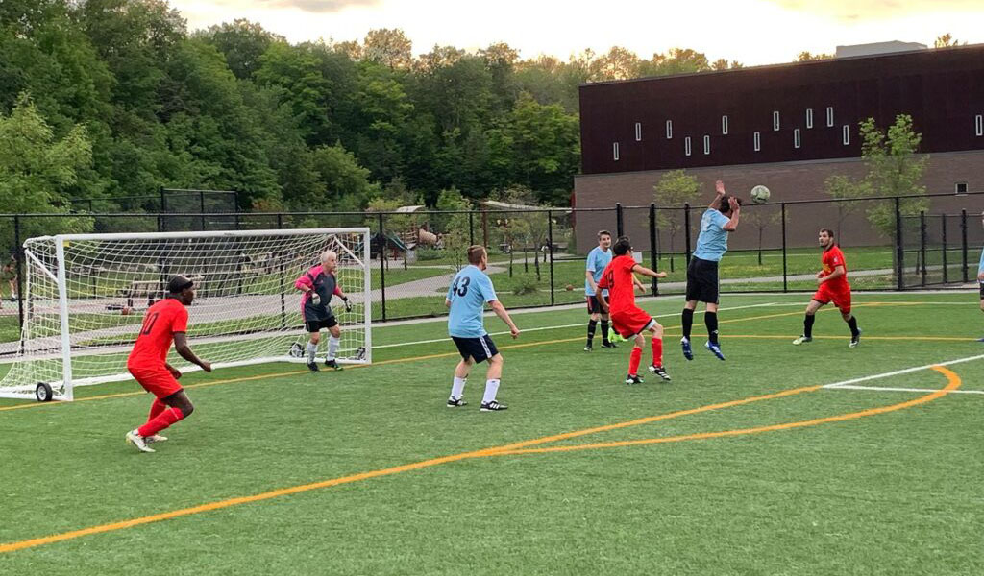
What is the entry process?
The entry fee is $800 plus HST
Entries will be accepted on a first come first
served basis
To enter complete an online registration form
and pay a $200 deposit
All entry fees must be paid by September 8th 2026
Your deposit will be returned if we are unable to
offer you a place in the OASC Fall league

Slide 6
Questions
Q. My team played 11 v 11 this summer, can we play in the Fall League?
Yes, however your roster will be restricted to 16 players
Q. My team played in the OCSL this summer, can we play in the Fall League?
Yes. The OASC fielded 85 teams this year including 15 in the OCSL. All our 85 teams can enter
Q. Can we sign new players for the Fall League?
Yes but each new player would have to also pay the EOS player registration fee of $40
Q. How many players can we have on a Fall league team?
A. Your roster can be 16 players and your can dress 14
Q. Can we merge with another OASC summer team to form a Fall League team?
Yes but please discuss the details with Dawn Dinsdale
Q. Are you scheduling games on Thanksgiving weekend?
No those games will be rescheduled to mid week in September
Q. Will the Fall League use registered referees?
A. Yes. All our match officials will be registered with Ontario Soccer for 2026

